Slide 1
Assignment-2
Software Product Management
Group - AY

Slide 2
Team Members:
N.Nikhil Sai Raj
Product Discovery

Slide 3
Agenda
Assigment-1 summary
MVP Features
Hand Drawn Sketches
Wireframe Storyboard
Customer Feedbacks
Improved Wireframed Storyboard
Key Learnings
Product Discovery

Slide 4


Assigment-1 Summary
Product Idea RoomieMatch is a application that streamlines the process of finding compatible roommates and affordable shared housing.
Target Customers
Young professionals
Students
Individuals seeking affordable shared living arrangements
Product Discovery

Slide 5
Assigment-1 Summary
Under-Served Needs
Traditional methods for finding roommates, such as online forums and personal networks, are often inefficient, unreliable, and lack transparency. Individuals struggle to find compatible roommates who share their lifestyle preferences and habits, leading to potential conflicts and a less than ideal living experience.
Product Discovery

Slide 6
Assigment-1 Summary
Value Proposition
RoomieMatch addresses these challenges by providing a safe and efficient platform for connecting users based on compatibility criteria.
Matching Algorithm: Connects users based on interests, habits, and lifestyle preferences.
Detailed Profiles: Allows users to showcase their personalities and living preferences.
Secure Communication: Built-in chat functionality facilitates safe and easy communication between potential roommates.
Verified Profiles and Reviews (Future): Promotes trust and transparency through a potential review system (depending on development).
Product Discovery

Slide 7
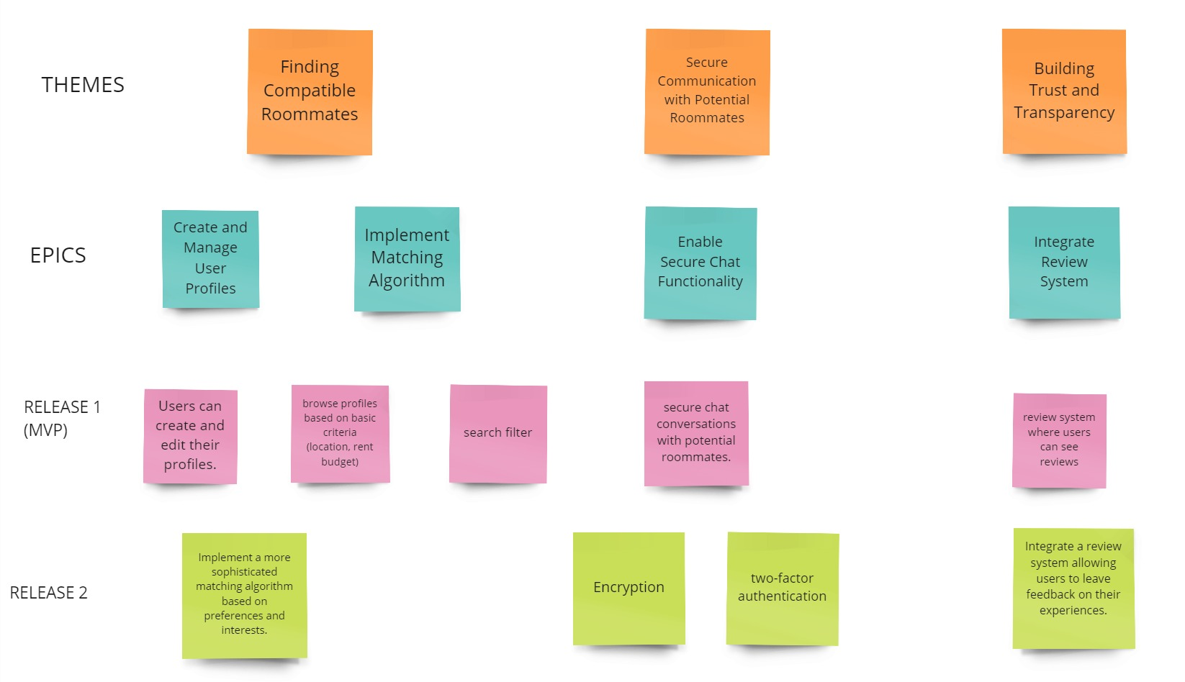
Assigment-1 Summary
Story Map
Product Discovery

Slide 8
MVP Features

Slide 9
MVP Features & it’s need
Core Features and Why They're in the MVP:
The MVP of RoomieMatch focuses on essential functionalities that address the core needs of users seeking compatible roommates. These features allow for initial testing and user feedback before adding more complex functionalities.
1. User Profile Creation:
Why it's in the MVP: Profiles are crucial for showcasing personalities, interests, and living preferences. This information is vital for the matching algorithm and building trust between potential roommates.
2. Search Functionality:
Why it's in the MVP: Users need a way to find potential roommates based on basic criteria. This reduces browsing fatigue and streamlines the search process.
Product Discovery

Slide 10
MVP Features & it’s need
3. Secure Chat:
Why it's in the MVP: Facilitates safe and controlled communication between potential roommates without compromising privacy. This allows users to connect and learn more about each other before committing to a shared living arrangement.
4. Matching Algorithm (Basic):
Why it's in the MVP: In the MVP, the algorithm connects users based on location and rent budget. This provides a starting point for compatible matches, to be refined later based on user feedback and additional data points.
Product Discovery

Slide 11
Hand Drawn Sketch

Slide 12
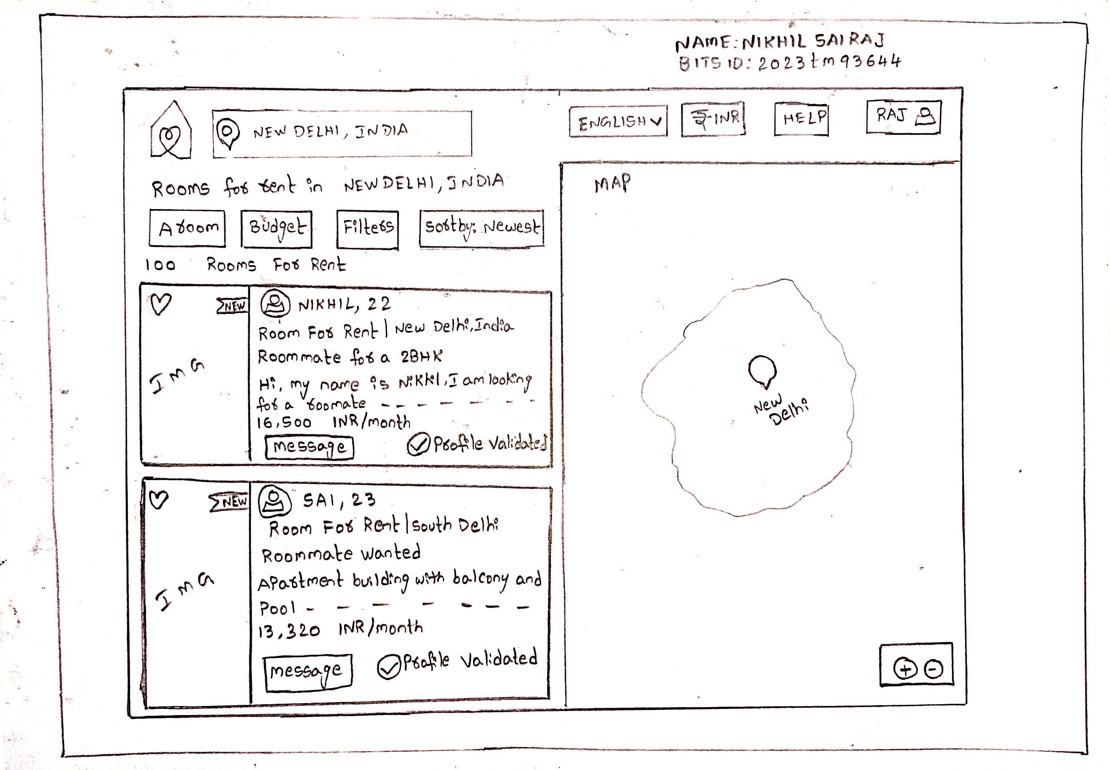
Hand Drawn Sketch
Product Discovery

Slide 13
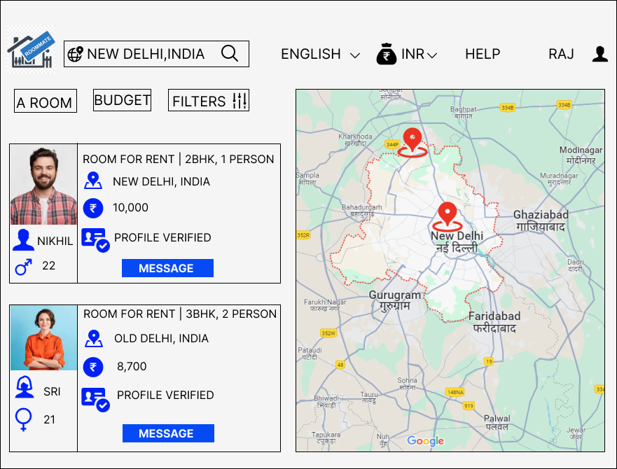
Wireframe Story Board
Based on the selected sketch, I have created a wireframe that includes all the features listed in the finalized sketch.
I have included a Filter button based upon our preferences we can select our roommate.
User profile will be validate based upon the details user provided.
If you like the room and roommate Interest means you can chat with users directly.

Slide 14
Customer Feedback
Customer 1:
The app concept overall looks good. But I have doubt how does the app offer any safety tips for meeting potential roommates in person?
Customer 2:
How does RoomieMatch handle situations where roommates have conflicts after moving in? (Wants to know there's some recourse if issues arise)
Customer 3:
How does RoomieMatch handle inappropriate behavior or harassment within the app?
Customer 4:
Can users leave reviews or ratings for past roommates? So that they will get to now more and detailed about the roommate.
Customer 5:
Is there a way to block or remove someone from contacting me if I feel uncomfortable?

Slide 15
Customer Questions and Solution
Based on the wireframe presentation, we received feedback from our potential customers on specific aspects of the app. Here are the questions raised and the proposed solutions:
1. Does the app offer any safety tips for meeting potential roommates in person?
Answer:
Here are some specific safety tips that we can include in the app
.Meet in a public place: Advise users to suggest well-lit and populated locations for initial meetings, like cafes, libraries, or parks.
Bring a friend or let someone know: Encourage users to inform a friend or family member about the meeting details (location, time, roommate's name).
Avoid sharing personal information: Discourage users from sharing their home address or other sensitive details until they feel comfortable with the potential roommate.
Consider video calls before meeting: Suggest video calls within the app as a way to get a better sense of the person before meeting in person.

Slide 16
Customer Questions and Solution
2.How does RoomieMatch handle situations where roommates have conflicts after moving in? (Wants to know there's some recourse if issues arise)
Answer:
Provide a dedicated section within the app with resources for conflict resolution.
Offer templates for creating roommate agreements outlining expectations and responsibilities.
3. How does RoomieMatch handle inappropriate behavior or harassment within the app?
Answer:
Implement a clear and easy-to-use reporting system for users to flag inappropriate messages or behavior.
This can be achieved through a dedicated "Report" button within the chat interface.
The reporting system should allow users to specify the nature of the offense (e.g., offensive language, harassment, threats).

Slide 17
Customer Questions and Solution
4. Can users leave reviews or ratings for past roommates? (Seeks insights from other users)
Answer:
Presently we are not providing that feature, but In future we will put that in our application.
5. Is there a way to block or remove someone from contacting me if I feel uncomfortable?
Answer:
Absolutely! RoomieMatch always prioritize user comfort and control over communication. Here's how to address this concern:
Blocking Functionality:
Implementing a clear and easy-to-use "Block" functionality within the chat interface.
This allows users to block someone from sending them further messages.
Once blocked, the user will no longer see messages from the blocked individual.

Slide 18
Updated Wireframe Story Board

Slide 20
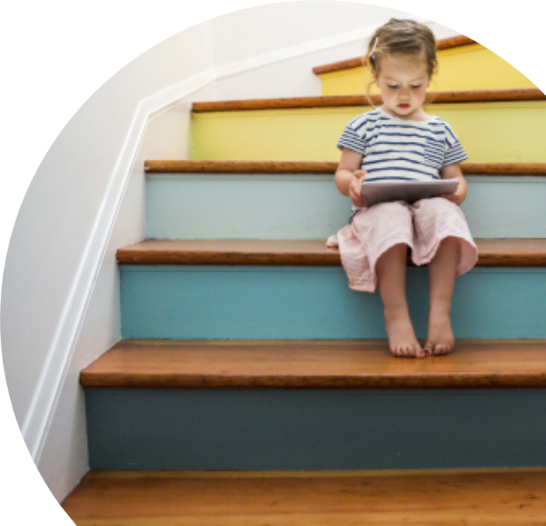
Key Learnings – Nikhil (2023TM93644)
Starting with a product sketch: Hand-sketching product ideas can be a useful starting point to get ideas on paper and sharing them with the team.
Converting the sketch into a wireframe: Once the product sketch is ready, it's important to convert it into a digital wireframe to add more detail and create a clearer picture of what the product will look like.
Identifying MVP features: Finding out the most important features required for the product is important and those features need to be prioritized.
Importance of customer feedback: Seeking feedback from customers is crucial for creating a successful product. By listening to their suggestions and concerns, we can improve the product and make it more user-friendly.
Presentation Title

Slide 21


Thank you
Nikhil Sai Raj .N - Group AY
2023tm93644@wilp.bits-pilani.ac.in
Product Discovery

